Slide 1



AI and IoT based Remote monitoring and Alerting of Human Elephant Conflict Mitigation
Dr. J John Paul
AP/ECE
Karunya Institute of Technology and Sciences

Slide 2
Overview of Human-Elephant Conflict (HEC)
Human-Elephant Conflict (HEC) refers to the negative interactions between humans and elephants, often resulting in human causalities, economic losses, elephant morality.
Human Casualties: Elephants can cause injuries or fatalities when they come into contact with humans.
Economic Losses: Crop damage, property destruction, and loss of livelihoods are significant economic burdens for communities living near elephant habitats.
Elephant Mortality: Elephants are often killed by humans through poaching, poisoning, or accidents (e.g., train collisions).

Slide 3
Statistics from Research Papers and Reports
According to the World Wildlife Fund (WWF), human-elephant conflict affects over 60% of the Asian elephant range countries, with significant economic losses reported in India, Sri Lanka, and Southeast Asia.
India : A study published in PLOS ONE (2020) estimated that India experiences an average of 400 human deaths and 100 elephant deaths annually due to HEC.
Crop damage caused by elephants in India is estimated to cost farmers $10–15 million USD annually (Source: IUCN Report, 2019).

Slide 4
Conventional Methods to Avoid Human-Animal Conflict
Electric Fences: Used to deter animals like elephants and tigers from entering human settlements.
Dogs and Donkeys: Used to scare away predators like wolves and leopards.
Firecrackers and Flashlights: Used to scare animals away.
Limitations:
High maintenance costs for fencing
Not effective against larger animals like elephants or bears
Leading to frustration among communities

Slide 5
AI and IoT Can Provide Better and simpler Solutions
Artificial Intelligence (AI) and the Internet of Things (IoT) offer innovative, cost-effective, and scalable solutions to mitigate human-animal conflict.
Advantages:
Early warning systems – Provides proactive, preventive and early information
Real – Time monitoring - Enables 24/7 monitoring and immediate response to potential conflicts.
Data driven decision making - Helps authorities make informed decisions and allocate resources effectively.
Non-Lethal: Minimizes harm to wildlife while protecting human interests.

Slide 6
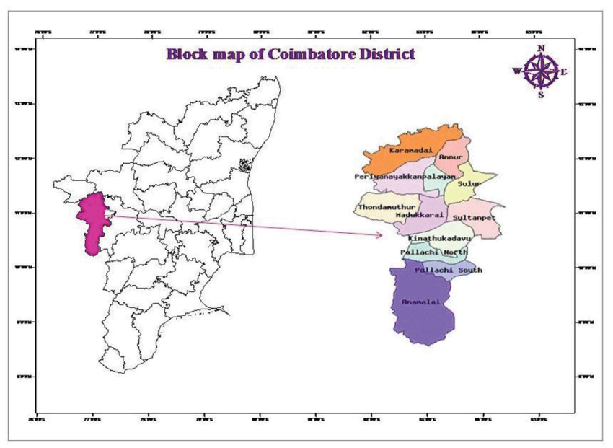

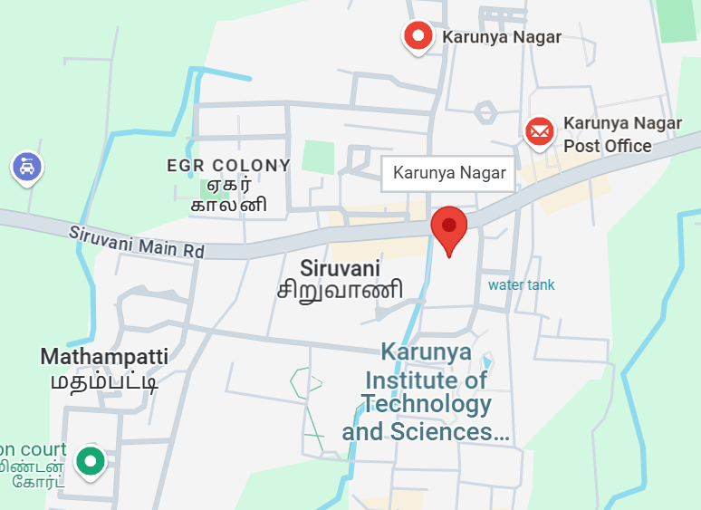
1) Conflict Zone - Study area - Kalimangalam
Initially a study was conducted to identify the high conflict zones more prone to attacks from historical data.
The identified village was Kalimangalam, which is in Coimbatore district of Tamil Nadu, India. Because of its closeness to the Western Ghats, a biodiversity hotspot region for Asian Elephants.
Next we tried to collaborate with the local authorities and communities to identify the locate the elephant pathway.

Slide 7
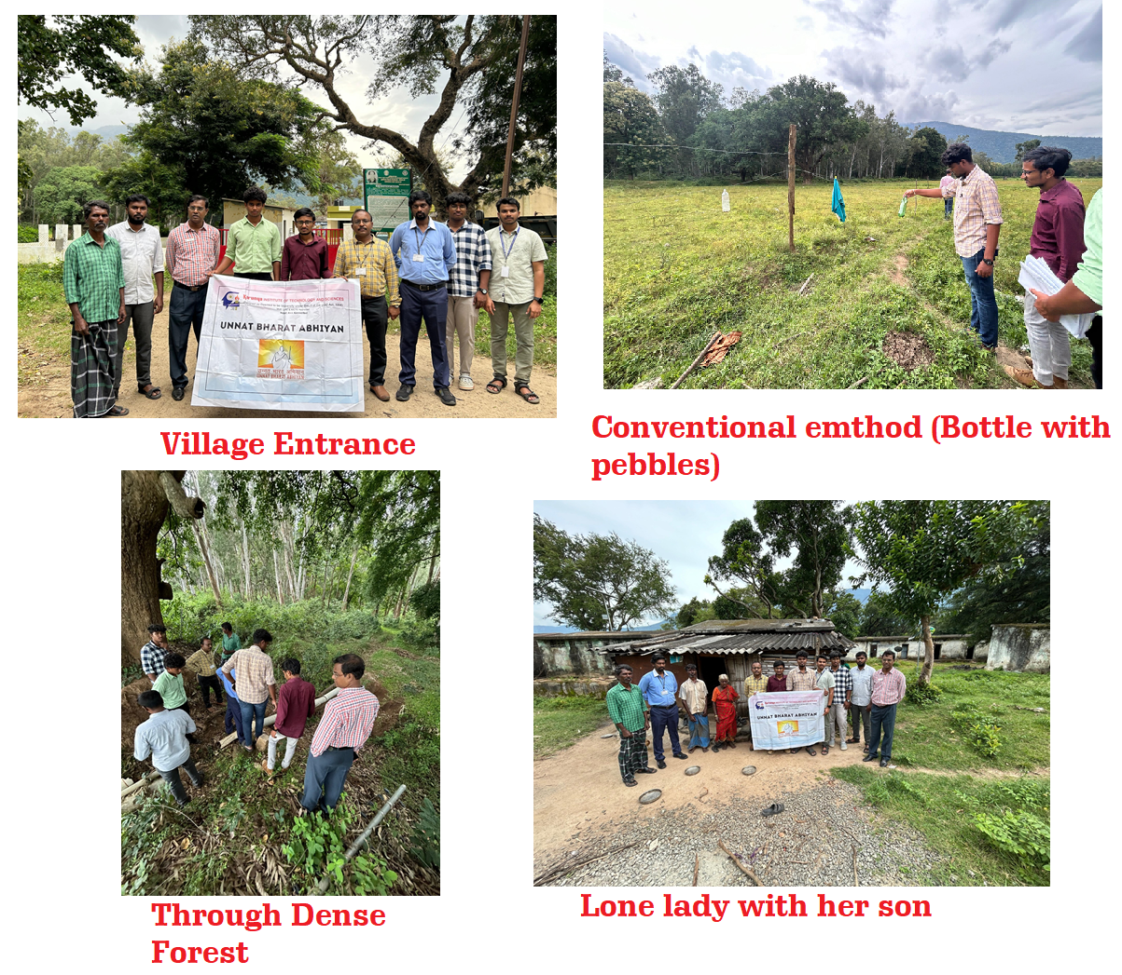
Biodiversity hotspot - Kalimangalam Village
Photos from Left
Village entrance (school)
Conventional method (bottle and pebbles)
Way through Dense forest
(Elephant pathway)
Visited a Lone lady with her son

Slide 8
2) System Design
The System Design Phase is the backbone of the project, where the architecture, components, and functionalities of the AI and IoT-based system are defined.
This phase ensures that the system is scalable, efficient, and capable of addressing the specific challenges of human-animal conflict.
The system architecture is divided into three layers:
Data Collection Layer (IoT Devices)
Data Processing Layer (AI and Edge Computing)
User Interaction Layer (Alerts/Mobile App)

Slide 9
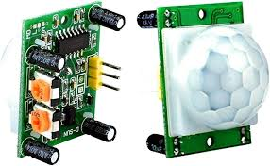
1) Data Collection Layer (IoT Devices)
Passive Infrared (PIR) Sensors:
PIR sensors detect heat emitted by animals (or humans) in the form of infrared radiation. When an animal moves within the sensor's range, it triggers an alert. (10 -20 units per sq.km)
E.g.. HC-SR501 PIR Motion Sensor
Specifications:
Detection Range: Up to 7 meters.
Detection Angle: 120 degrees.
Operating Voltage: 5V–20V DC.
Power Consumption: 65 mA.

Slide 10
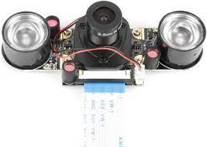
Data Collection Layer (IoT Devices)
Active IR Camera:
The DS-2CD2043G0-I is a 4MP camera with active infrared (IR) night vision with protection against dust and water, designed for outdoor security surveillance.
Specifications:
Resolution: 4 MP (2688 × 1520).
Night Vision Range: Up to 30 meters (with built-in IR LEDs).
Day Vision: Full-color imaging.
Weatherproof Rating: IP67.
Power Supply: 12V DC
Thermal IR cameras detect elephants
from long distances.
PIR provide additional motion detection.

Slide 11
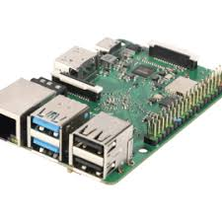
2) Data Processing Layer (Edge computing)
Preferred Model: Raspberry Pi 4
Raspberry Pi can be used for AI-powered elephant detection in wildlife conservation, by combining camera and computer vision libraries (like OpenCV), enables various image processing tasks.
By integrating machine learning and computer vision, Raspberry Pi enables real-time monitoring and alerts.
Specifications:
Compact & Affordable: Small in size, low power consumption.
Runs Linux-based OS: Typically Raspberry Pi OS (Raspbian) but also supports Ubuntu, Windows IoT, and others.
Connectivity: Includes Wi-Fi, Bluetooth, USB, HDMI, Ethernet, and sometimes PoE support.

Slide 12
Comparison of Edge devices
Feature | Arduino | STM32 | Raspberry Pi
Processing Power | Low | Medium | High
Memory | Low | Medium | High
Operating System Support | No OS | Limited RTOS | Full OS
Machine Learning Support | Limited | Moderate | Extensive
Ease of Development | High | Moderate | High
Connectivity Options | Low | Moderate | High
Community Support | High | Moderate | Very High
Cost | Low | Medium | Medium

Slide 13
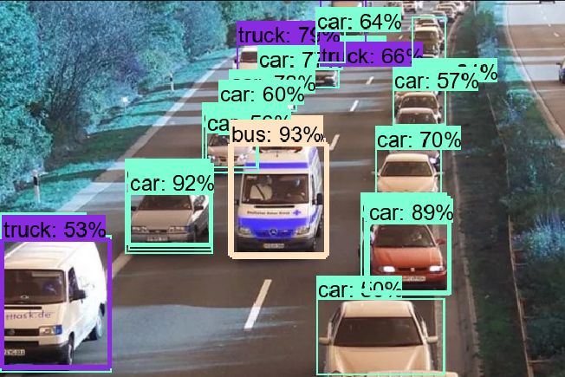
AI Algorithm - YOLO (You Only Look Once)
Algorithm Overview
YOLO treats object detection as a single regression problem rather than a two-step process like Faster R-CNN.
It divides an image into a grid and predicts bounding boxes and class probabilities for objects in one forward pass.
Outputs bounding boxes, confidence scores, and class probabilities in a single run.
Advantages for Human-Animal Conflict Applications
Real-time detection – Ideal for real-time monitoring of wildlife near human settlements.
High-speed processing – Can process video feeds from drones and surveillance cameras efficiently.
Compact model – Can be deployed on edge devices like Raspberry Pi, drones, and mobile devices.

Slide 14
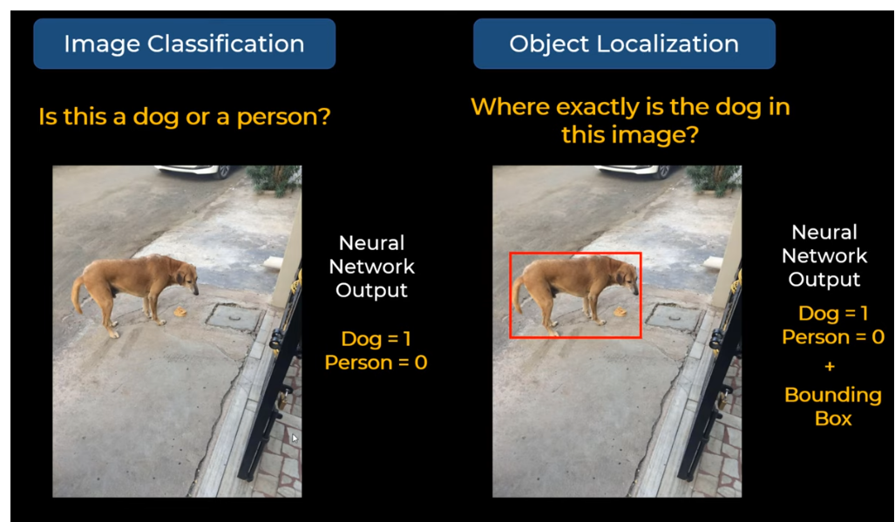

AI algorithms – Object detection (YOLO)

Slide 15
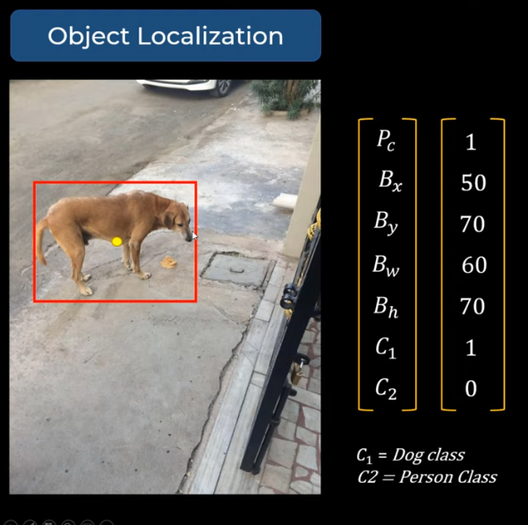
AI algorithms - (YOLO)

Slide 16
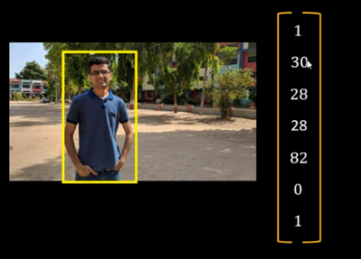
AI algorithms - (YOLO)

Slide 17
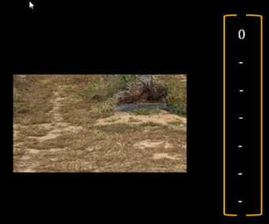
AI algorithms - (YOLO)

Slide 18
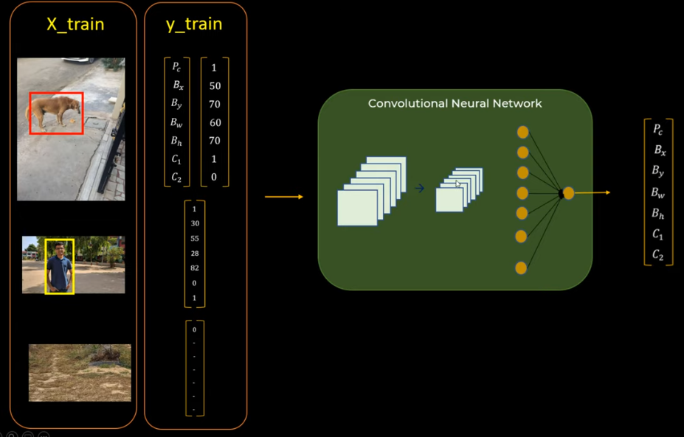
AI algorithms (YOLO)

Slide 19
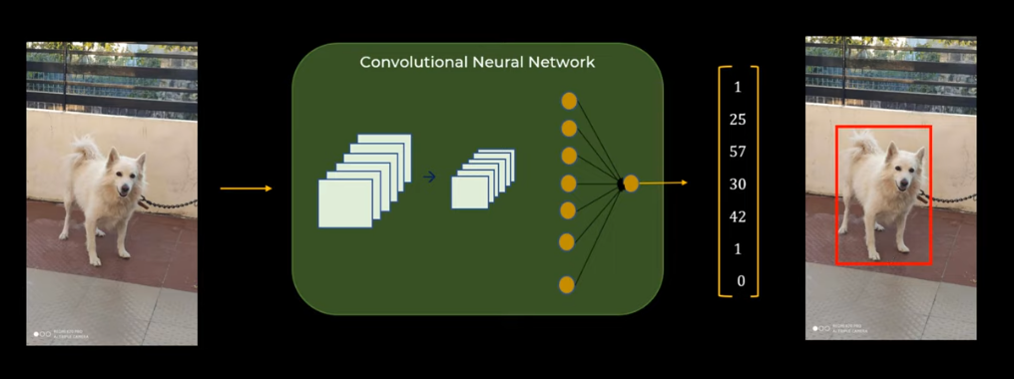
AI algorithms (YOLO)

Slide 20
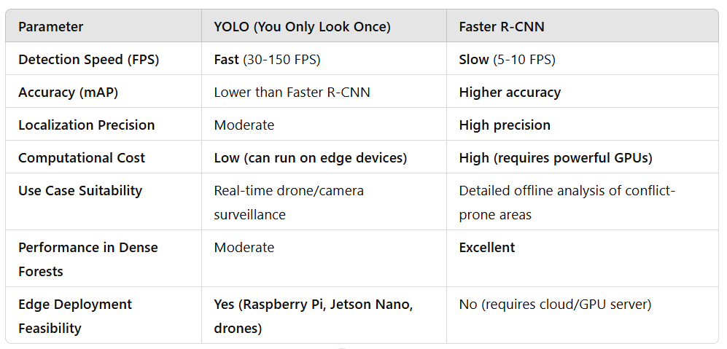
Parameter Comparison for Human-Animal Conflict Detection

Slide 21
What is TinyML and TensorFlow?
TinyML (Tiny Machine Learning) is a low-power, compact machine learning approach designed to run on embedded systems and edge devices such as microcontrollers (MCUs), IoT devices, and wearables.
Tiny-YOLO (YOLOv4-tiny or YOLOv5n) is a lightweight version of YOLO that can run on edge AI hardware such as Nvidia Jetson Nano, Raspberry Pi, and microcontrollers.
TensorFlow is an open-source machine learning framework developed by Google for building, training, and deploying AI models. It supports deep learning, neural networks, and large-scale AI applications.

Slide 22
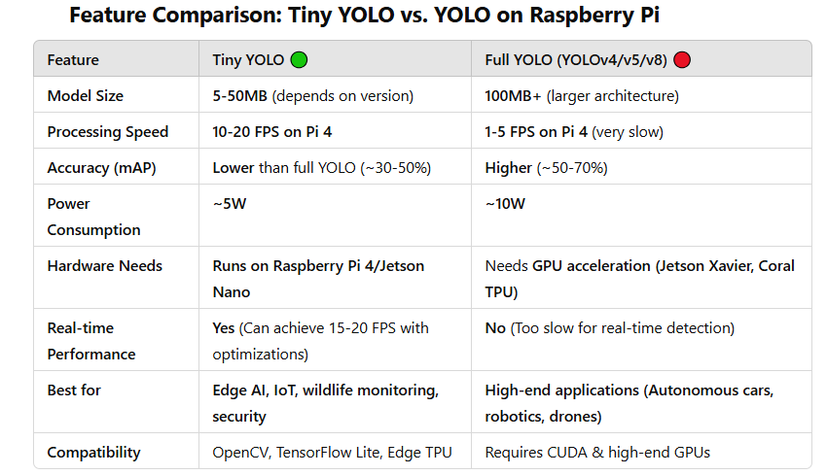
TensorFlow – Good for training the models in real-time.
Open CV – Better for deploying models in real-time

Slide 23
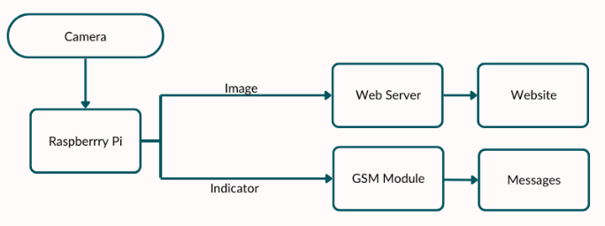
User Interaction Layer (Alerts/Mobile App)

Slide 24
GSM Module and Web Page/App
In the first module we use a GSM module for communication and alerting. In addition, this system will operate in areas with low or no access to the Internet so that the alerts are provided in the form of messages .
Camera and Raspberry Pi: The camera takes pictures of the area and the Raspberry Pi analyzes them by TinyML models to identify any sign of elephants. However, one of the limitations is that the Raspberry Pi forwards the processed images to a web interface for visualization on a website.
Web Server and Website: The images acquired and analyzed by the system are displayed on the website for observation purposes.
GSM Module: When the Raspberry Pi detects any abnormality, it triggers an alarm signal to the GSM module which in turn warns the specificAuthority/People/Local Communities via a built-in SMS or call.

Slide 25
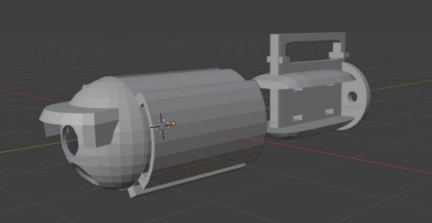
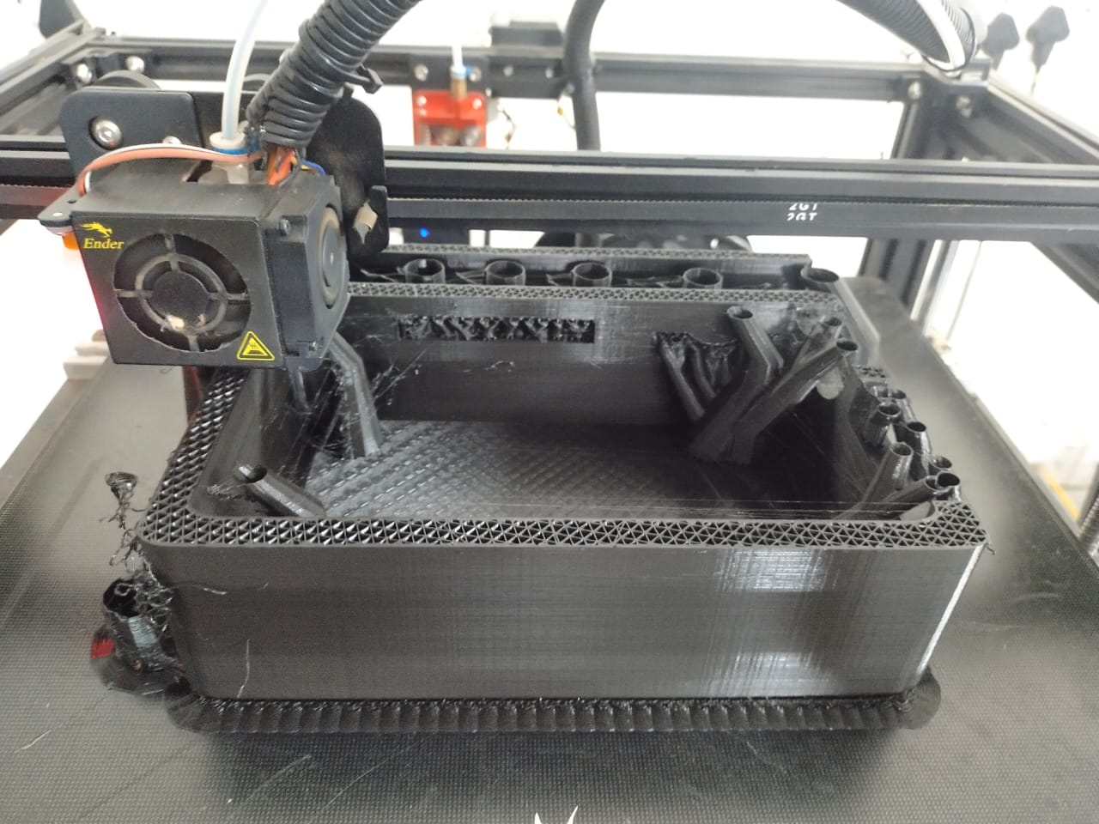
3D Modeling
Three 3D models were created and printed using PLA material. These models were intended for housing and shielding the sensors as well as other electronics necessary for identification and signalling.
PLA was chosen because of its durability and ease in which it can be printed while being a naturally biodegradable material so the enclosures are lightweight yet strong enough to handle the elements.
The designs also provide for modularity to be incorporated in 3D printing allowing easy service and installation of new parts.
PLA – Polyactic acid (Bioplastic)

Slide 26
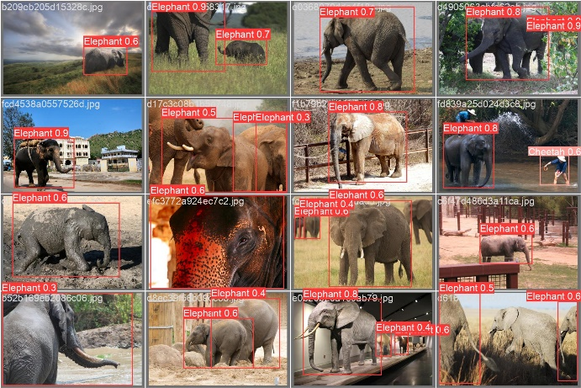
Results – Images of Elephant detection
In total the database contains 2,193 photos split within the three sets: 1,730 for training, 345 for testing, and 118 for validation.
The images acquired
while training.

Slide 27
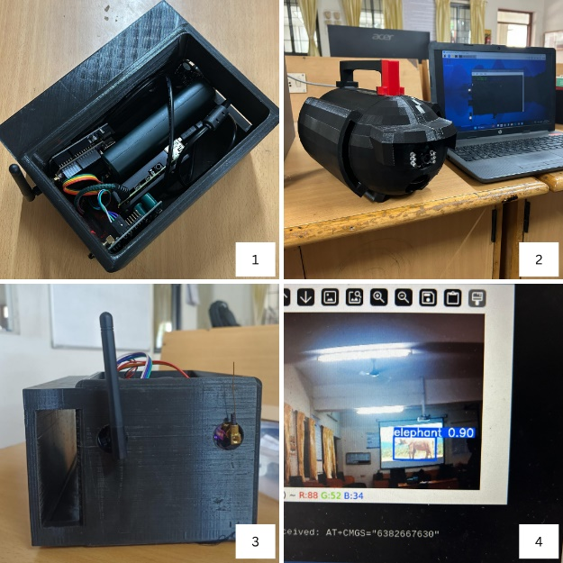
Results – Models developed and Tested in Lab
Model 1 : RPI with GSM
Model 2 : RPI with LoRaWAN
Model 3 : RPI with Wifi and Speaker
Detected Image of Elephant

Slide 28
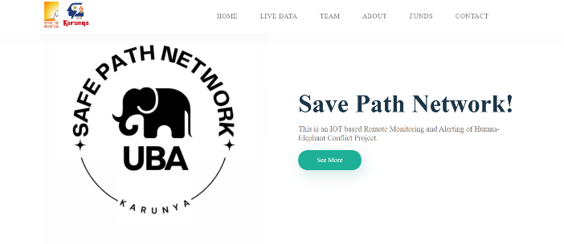
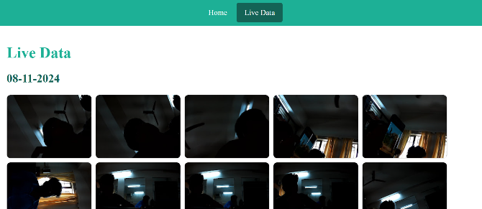
Results – Webpage Live data

Slide 29
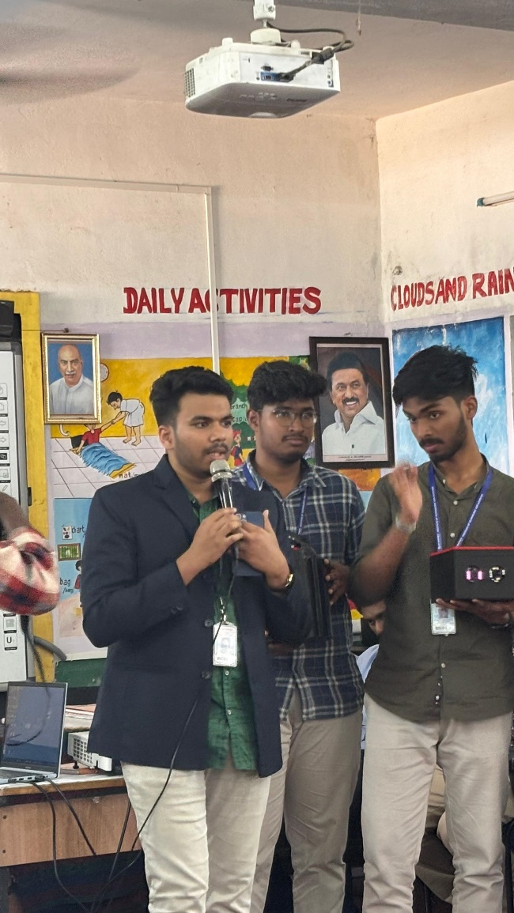
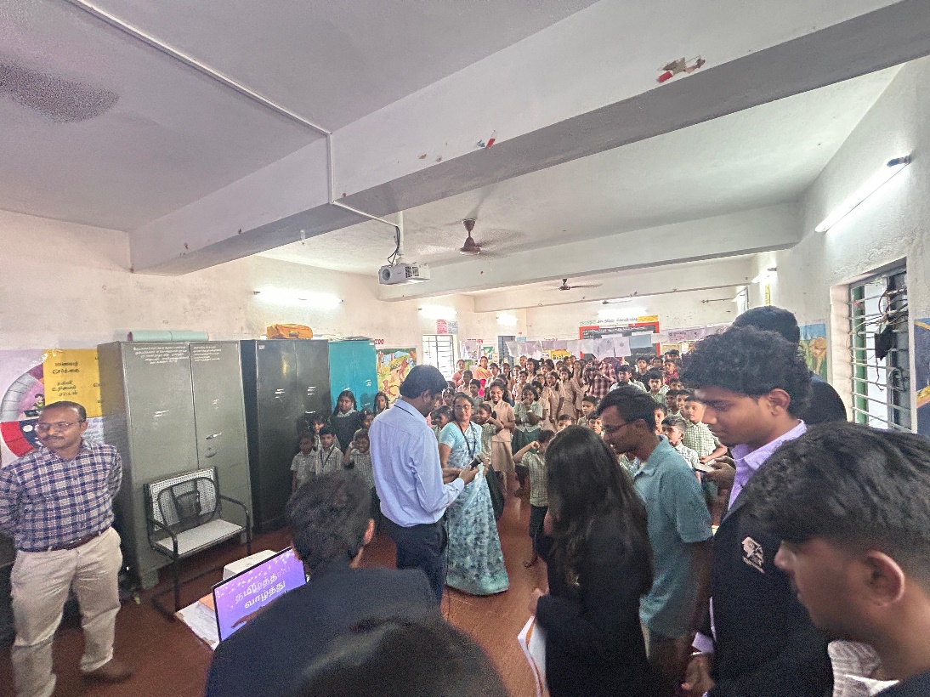
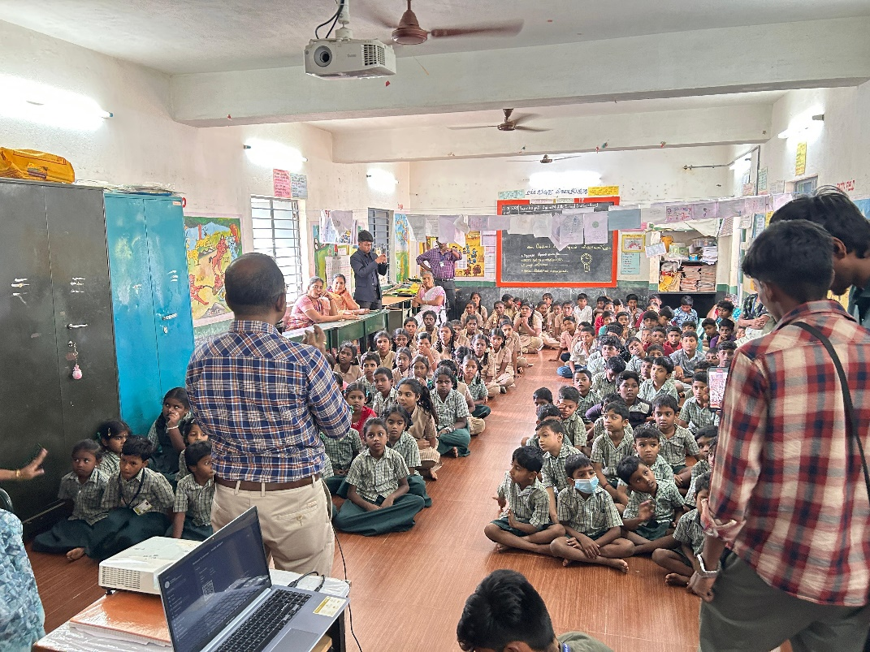
Implementation in Kalimangalam School

Slide 30


